Slide 1
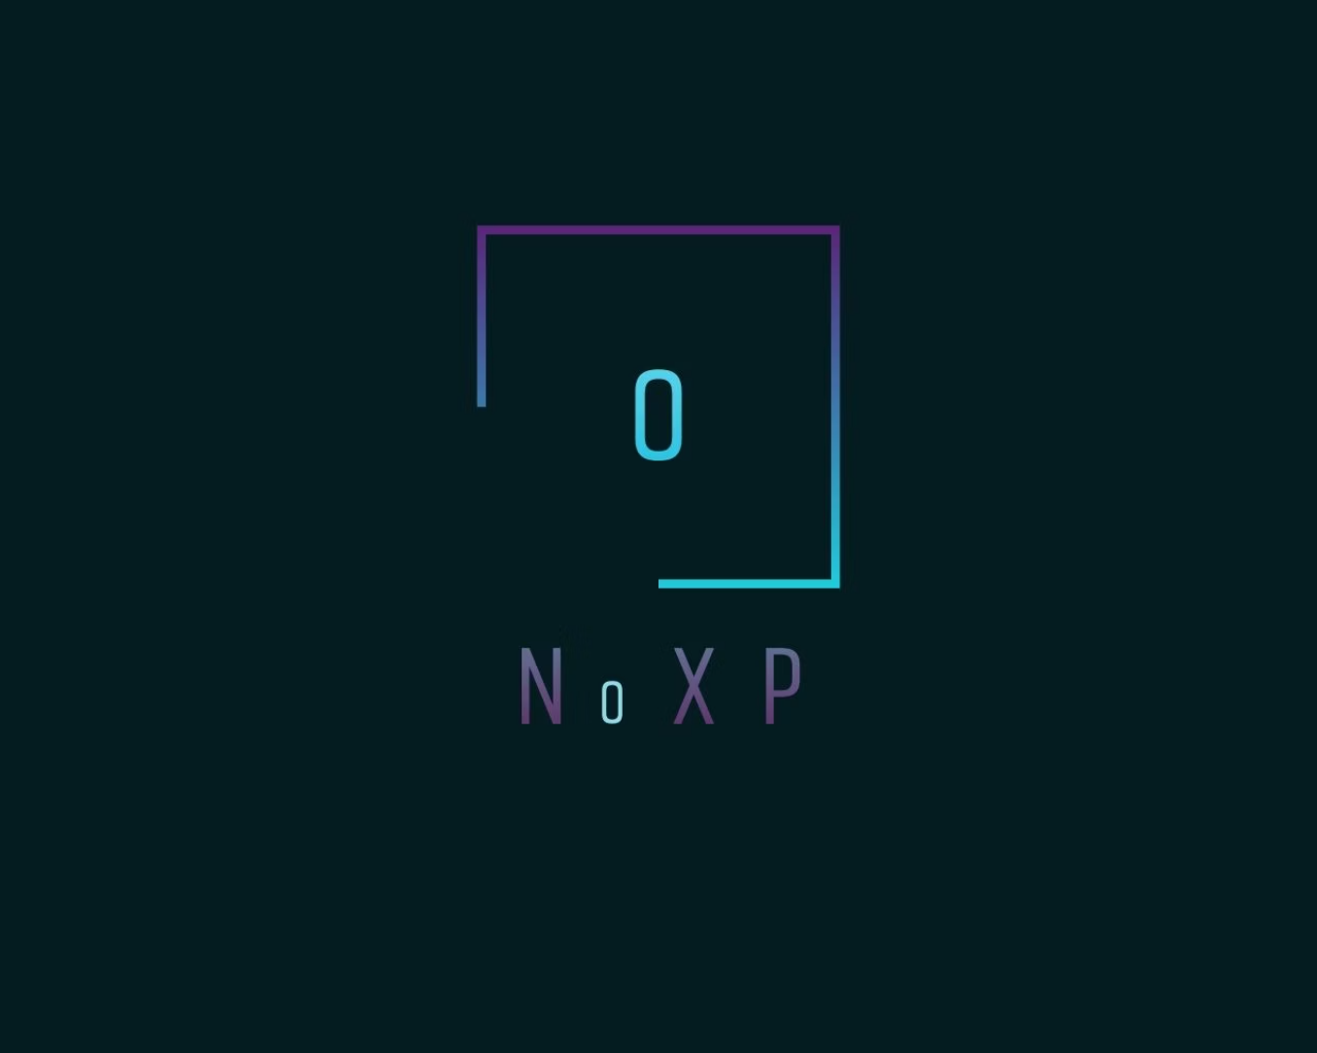
Tech Lead- Bhagabanta Giri
Pitch Designer- Ronit Kumar Patra
UI/UX Designer- Mahesh Gouda
Data Analyst- Ashutosh Kar
First Hack — Zero Sleep — Infinite Ideas

Slide 2

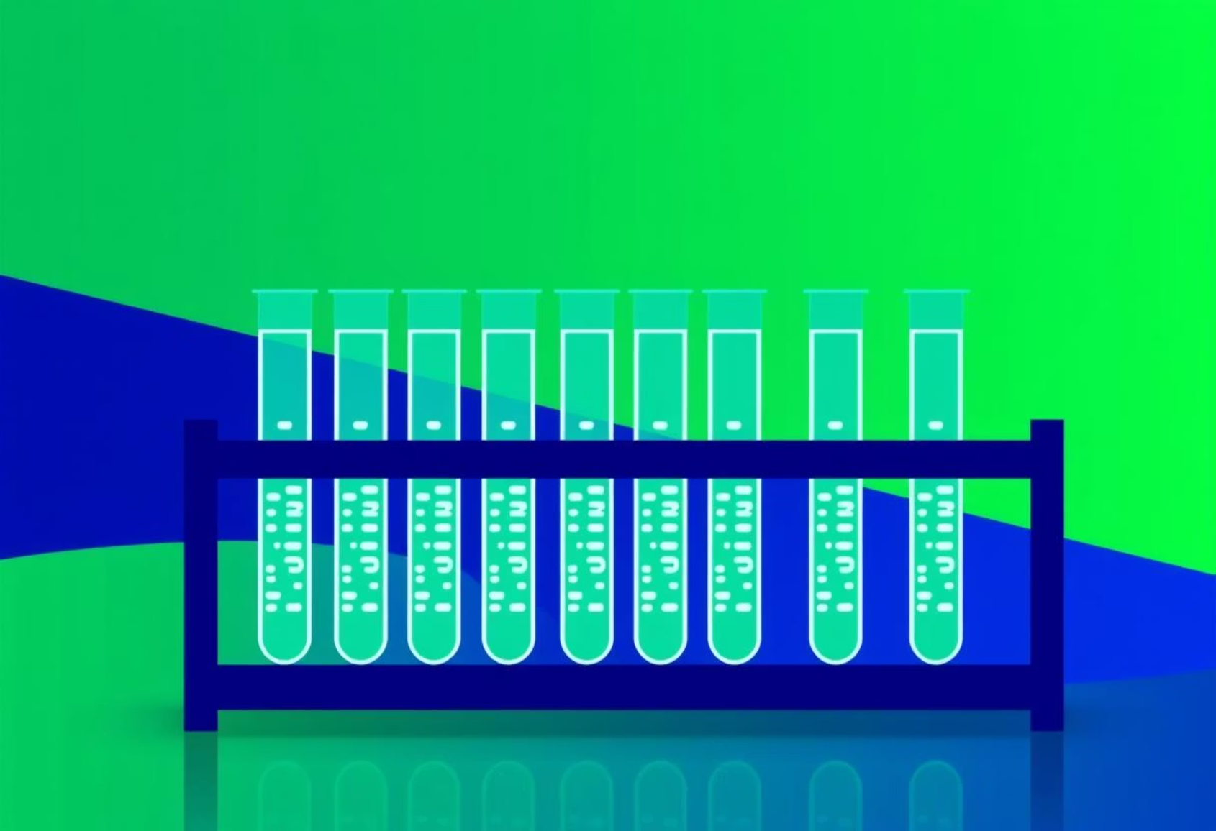
Your Digital Lab: Pairfinder & PCR Simulator
Ever dreamt of a lab where pipettes are passé and gloves are for gardening? Our bespoke Python toolkit offers just that! Dive into two innovative modules:
DNA Chain Analysis Pairfinder
PCR Simulator
Your personal molecular matchmaker, ensuring DNA pairings are always spot-on and drama-free.
A pure Python marvel, replicating the classic Polymerase Chain Reaction with a dash of randomness and a heap of humour.

Slide 3

Meet Pairfinder: The DNA Matchmaker Extraordinaire
Our DNA Chain Analysis Pairfinder isn't just a piece of code; it's the ultimate chaperone for your nucleic acids. It understands the fundamental rules of life, ensuring every pair is picture-perfect!
The Original Gangsters
No Room for Nonsense
It impeccably matches Adenine (A) ↔ Thymine (T) and Guanine (G) ↔ Cytosine (C). The classic, unbreakable bonds!
Like a true alpha, Pairfinder bravely ignores non-sense cases, ensuring your data remains pristine and biologically relevant.

Slide 4



Pairfinder's Vigilance: Beyond the Basics
But the Pairfinder's talents extend beyond simple matching. It's also your personal DNA diagnostician, ensuring the integrity and health of your genetic sequences.
Flags Illegal Characters
DNA Diagnosis
Clean & Compliant
Swiftly identifies and flags any 'toxic relationships' or illegal characters that shouldn't be in your DNA sequence. No unwelcome surprises here!
It provides a comprehensive diagnosis: is your DNA healthy and robust, or is it a tangled mess full of drama? Get the full genetic scoop!
Ultimately, Pairfinder helps you maintain clean, compliant, and biologically sound DNA sequences for your analyses.

Slide 5
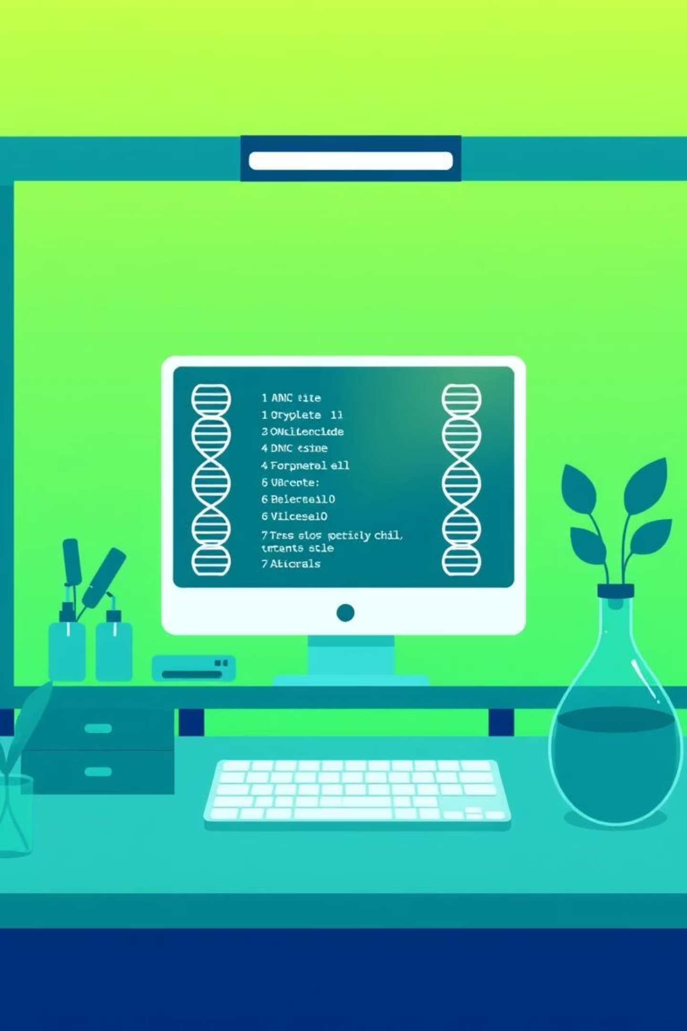
Introducing the PCR Simulator: Your Virtual Amplification Lab
This isn't your average "Hello World" program. This is a Polymerase Chain Reaction (PCR) Simulator built from the ground up in pure Python. It meticulously mimics the three classic steps of PCR, infused with elements of randomness, precise logic, and a dash of British humour.
"No pipettes. No gloves. Just pure, unadulterated code."

Slide 6



PCR Step One: Denaturation – The Big Heat Up
Every great reaction starts with a bit of heat! In our simulator, the denaturation phase is where the DNA unwinds, preparing for the magic of amplification. It's hot, chaotic, and essential.
Defect Rejection
Simulated Heating (95°C)
If the initial random DNA is too 'defective', it's rejected. Only the fittest DNA survives this rigorous pre-amplification check!
Random DNA Generation
Mimicking the actual PCR process, the DNA is 'heated' to a virtual 95°C, causing the double helix to separate.
The simulator kicks off by generating a random DNA strand. Just like in nature, not every sequence is perfect.

Slide 7
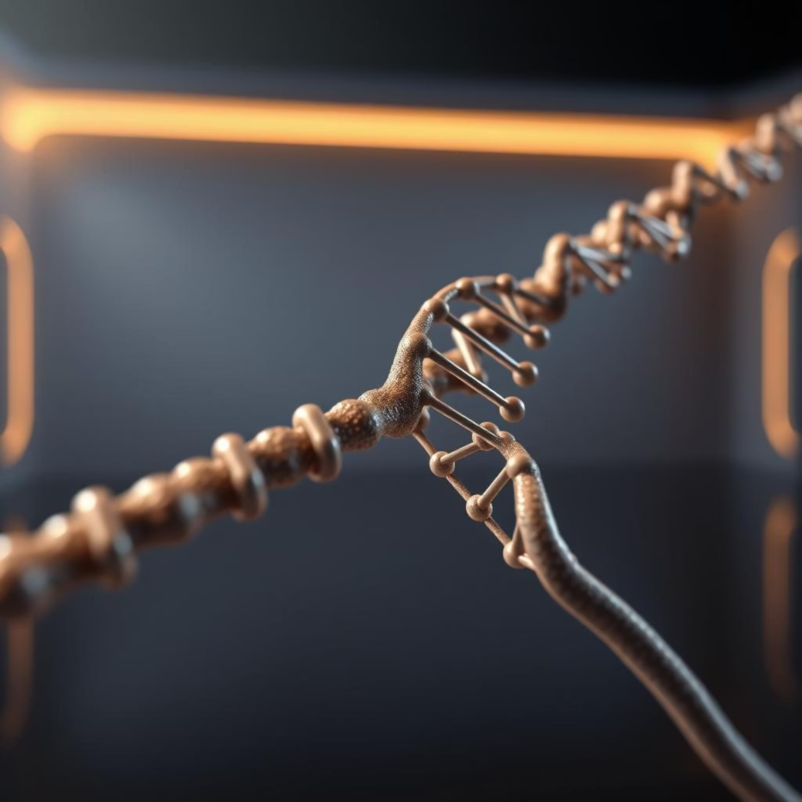

PCR Steps Two & Three: Annealing & Extension
With the DNA denatured, the next crucial steps involve the primers finding their targets and the DNA polymerase getting to work, extending those crucial strands.
Annealing (60°C)
You input a primer, and our simulator coolly (to 60°C!) matches it to the complementary DNA sequence, just like in a real lab.
Extension
The matched segment is then 'cloned'. Any inherent defects are precisely trimmed away, leaving you with pristine, newly synthesised DNA.
Clean Product
This intelligent trimming ensures that only clean, high-quality DNA strands are carried forward for further analysis.

Slide 8








Multi-Cycle PCR: Amplifying Your Insights
The real power of PCR lies in its ability to amplify minute amounts of DNA. Our simulator faithfully replicates this, allowing for multiple cycles and providing insights into the process efficiency.
Denaturation
Annealing
DNA unzips.
Precoursed DNA.
Product & Time
Precursored DNAExtension
Final yield and total 'lab' time calculated.
New strands form.
Add in your desired number of PCR cycles, observe the exponential amplification of your digital DNA, and calculate your total "lab" time. All without a single real-world reagent!

Slide 9




PCR Simulator: Under the Hood - Core Features
What makes our PCR Simulator tick? It's packed with intelligent features designed for both realism and ease of use, all built upon robust Python logic.
Random DNA Generator
Defect-Check Loop
Creates 25-base long DNA strands, including potential defects for a realistic simulation environment.
An intelligent loop ensures DNA quality, retrying until the sequence is 'good enough' for amplification.
Precoursed DNA Logic
Defect Slicing
Employs sophisticated logic to simulate accurate DNA annealing, just like the actual biological process.
During the extension phase, the simulator detects and precisely 'cuts out' errors, ensuring a clean amplified product.

Slide 10

More Features & Why Python Reigns Supreme
Our simulator continues to impress with its advanced capabilities, all while maintaining a lean, dependency-free core.
Key Enhancements
Built with Core Python
Multi-Cycle PCR Simulation: Repeat your cloning like a pro, observing exponential DNA amplification.
Perhaps the most brilliant feature:
This entire simulator is built with pure, raw Python logic. No fancy external dependencies are required. This ensures high performance, easy integration, and a clear understanding of the underlying algorithms.
Time Estimator: Provides an estimate for how long your simulated PCR 'lab' work takes.
It's a testament to Python's power in tackling complex scientific simulations.
Happy coding, and may your DNA always be amplified!

